Slide 1
Dynamic Routing Protocol(RIP) On GNS3 Using Cisco IOS
Vishwanath Jadhav 20/03/2019

Slide 2
Table Of Contents
Routing Protocols.
Routing Methods.
Dynamic routing protocols
What is GNS3.
Cisco IOS.
RIP protocol.
Demo RIP on GNS3
References

Slide 3
Routing Protocols
Definition:
Delevers packet from one device in one network to other device on another network through best path, irrespective of host.
When do we use router ? Router is used only when network is not connected to the device/host
When network is not connected then need to use static route or dynamic routing information.
What affects the routing:
Destination address
Neighbour router
Possible routes to all the remote networks
Best Route to each remote network
Verify and maintain router information
Router learns about remote network from neighbour router or admini.

Slide 4
Routing Protocols
Routed protocols and Routing protocols:
Routed protocols are used to send user data through the established network.
Routed protocols are assigned to interface with which packets can be delivered. E.g: IPv4 and IPv6
Routing protocols generate routing information for the networks, with which router route the packet through internetworks to destination. Eg: RIP, OSPF, EIGRP.
Once the routing information is set(Routing table are converged)

Slide 5
Routing Methods
Default Routing
One single exit point for a stub network(end of network beyond which there is no network eg. LAN).
It’s administrative distance is 0.
Static Routing
Network admin manually add routes in each router's routing table.
Administrative distance is 2
Pros:
No computation overhead
Small network can be handled with static route using chip routers.
Less bandwidth consumption while using protocols.
Cons:
Topology must be known.
Any change in topology, need to modify routes on each router.
For large network topology it's not efficient.

Slide 6
Routing Methods
Dynamic Routing
Protocols runs on the routers and shares the routing information with their neighbour routers.
Two types of dynamic routing protocols:
Interior Gateway Protocols (IGP) is used to exchange routing information in the same autonomous system(AS). Eg: RIP, OSPF
Exterior Gateway Protocols (EGP) is used to exchange routing information in the different autonomous system(AS). Eg: BGP

Slide 7
Dynamic routing protocol basics
Administrative distances (AD) of routing protocols
AD is used to rate the trustworthiness of routing information.
How does it impact on the routing
If get two advertised updates for same network from neighbor routers, then router will add the routing info with the lowest AD values.
If both the ADs are same then router will check for hop count and Link speed to select best path.

Slide 8
Dynamic routing protocol basics
Following table shows the AD value for routing protocols
Protocol | AD Value
Connected | 0
Static | 2
EIGRP | 5
External BGP | 20
OSPF | 110
RIP | 120

Slide 9
Dynamic routing protocol basics
Routing Protocol Clases
Distance Vector:
Best path for the remote network is chosen based on number of hops, link speed and direction to the remote network.
Distance vector routing protocol periodically sends entire routing table to directly connected neighbours. Eg: RIP, IGRP.
Link State:
These protocols are SPF (Shortest Path First Protocols).
Three Different Tables:
Table-1. Keeps the track of directly attached routers.
Table-2. Keeps the topology of entire network.
Table-3. Routing table.
Link state do not exchange routing tables periodically, instead it share link-state info, sends update using keepalive messages to maintain neighborship with the routers. Eg: OSPF, ISIS

Slide 10
Dynamic routing protocol basics
Routing Protocol Clases
Advance distance vector:
routing protocols are combination of distance vector routing protocols and link-state routing.
To keep the neighbourship, router uses periodic keepalive messages like Link-state routing protocols.
Like link-state it shares partial updates are send to neighbours when change occurs.
Router gets overall network information from the neighbor routers just like distance vector protocols. Eg: EIGRP(Open Source).

Slide 11
What is GNS3
GNS3 is GNU network simulator(Open Source).
GNS3 is multi-vendor platform(L2, L3 layer devices can be simulated using IOS or JunOS).
Complex network topology can be simulated on GNS3.

Slide 12
Cisco IOS
Cisco Internetwork Operating System for Cisco devices.
IOS provide command line interface to administrate the devices.
It has different privilege modes.
User mode
Privilege mode
Global configuration mode
Running configurations can be saved as startup configurations.

Slide 13
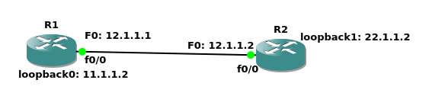
RIP Protocol
RFC details (RFC 2453)
Routing Information Protocol.
Distance vector routing protocol.
Works on Bellman Ford algorithm.
Application layer process with UDP port number(520), uses 224.0.0.9 as the multicast address to export its routes.
Administrative distance is (120) i.e trustworthiness.
RIP-v1(Classful i.e Same netmask for all the networks eg. 12.1.1.0/24, Loopback: 11.1.1.2/24, 22.1.1.2/24).

Slide 14
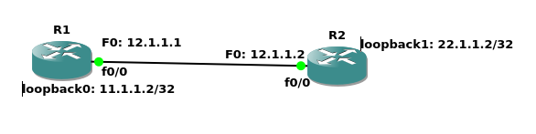
RIP Protocol
RFC details (RFC 2453)
RIP-V2(Classless 12.1.1.0/24, 22.1.1.2/32, 11.1.1.2/32)

Slide 15
RIP Protocol
Timers:
RIP has a update timer is of 30 seconds, it sends routing table updates to neighbor routers.
Hold on timer, router will hold the table entry for 180sec, if router do not received any update for the route it will start delete route process.
Router will keep the route which is under deletion process till Garbage-Collection timer timeouts.
Path Selection
Path selection is done based on metric value.
If either the router gets down then routing tables gets converged with latest Routing tables.

Slide 16
RIP Protocol
Split Horizon:
Helps to avoid route poisoning:
RIP protocol do not take route updates from neighbor router connected to the interface on which it has already send a router updates.

Slide 17
RIP Protocol
Triggered Updates:
If there is any change in the topology, then router will send updates to neighbour routers.
Router will update its routing table even though the metric value for the routes is high or low than the existing one.

Slide 18
RIP Protocol
Message Formats(refer pcap files):
Protocol Extension
Address Family
Route Tag
IP Address
Netmask
Next Hop (0.0.0.0) if next hop is not directly rechable then it should be treated as 0.0.0.0

Slide 19
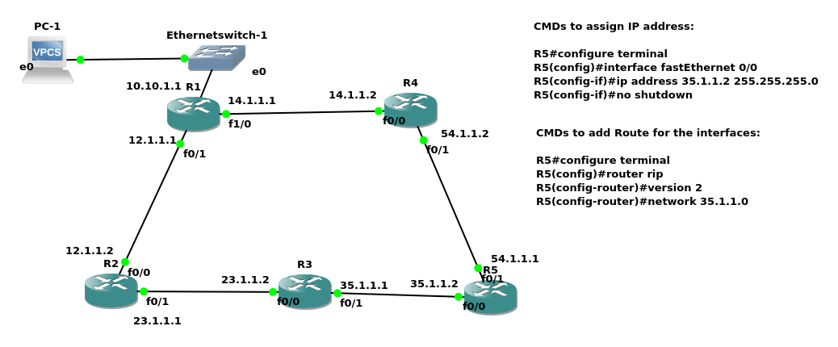
Demo RIP protocol on GNS3

Slide 20
References:
CCNA certification guide
RFC_2453
GNS3 installation
Downloads:
Router images for GNS3
C3725
C7200

Slide 21
Thank you
Vishwanath Jadhav

